Slide 1
Lecture-18
Inserting the Missing Character

Slide 2
Content
Concept
Examples
Practice questions

Slide 3
Concept:
questions contain a figure, a set of figures, an arrangement or a matrix, each of which bears certain characters, numbers, letters or a group/combination of letters/numbers which follow a particular pattern.
You are required to identify and decipher this pattern and accordingly find the missing character in the figure.

Slide 4


Example1 :
a) 7 b) 25 c) 49 d) 129

Slide 5


Example 2:
a) 45 b) 50 c) 60 d) 63

Slide 6
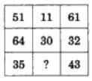
Practice Questions:
1.
25
27
32
37

Slide 7
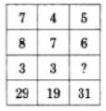
2.
3
4
5
6

Slide 8
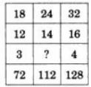
3.
2
3
4
5

Slide 9
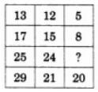
4.
7
9
11
15

Slide 10

5.
15
18
19
20

Slide 11

6.
19
17
16
15

Slide 12

7.
6
9
12
18

Slide 13

8.
25
37
41
47

Slide 14

9.
45
41
32
40

Slide 15
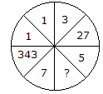
10.
25
625
125
50

Slide 16

11.
30
13
70
118

Slide 17

12.
60
46
86
75

Slide 18
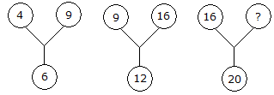
13.
60
50
25
21

Slide 19
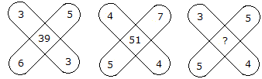
14.
47
45
37
35

Slide 20

15.
11
14
10
12

Slide 21


